Slide 1



HIV Testing
<Presenter, date>
Notes:
Add your name and date to the title slide
You may also wish to add your affiliation/organisation to this and subsequent slides.
We ask that you leave the OptTEST and EU acknowledgements on all slides from this slide set, along with any source information.

Slide 2
1. General profile of the HIV epidemic across Europe
2. Why Test for HIV?
3. Consequences of late diagnosis
4. Missed Opportunities
6. HIV testing strategies – including indicator condition guided HIV testing
5. Barriers to testing / Frequently raised concerns
Notes:
Narration
My talk today will cover a range of topics to demonstrate the urgent need for us to increase HIV testing; how we can most effectively achieve this, with a particular emphasis on indicator condition focused testing, and some patient and staff issues to consider.

Slide 3
1. General profile of the HIV epidemic across Europe
2. Why Test for HIV?
3. Consequences of late diagnosis
4. HIV testing strategies – including indicator condition guided HIV testing
Notes:
Narration
My talk today will cover a range of topics to demonstrate the urgent need for us to increase HIV testing; how we can most effectively achieve this, with a particular emphasis on indicator condition focused testing.

Slide 4


Number of adults and children living with HIV, 2014
North America and
Western and Central Europe
Eastern Europe
& Central Asia
1.5 million
2.4 million
[1.5 million – 3.5 million]
[1.3 million – 1.8 million]
Middle East & North Africa
240 000
Caribbean
280 000
Asia and the Pacific
5.0 million
[4.5 million – 5.6 million]
[210 000 – 340 000]
[150 000 – 320 000]
Latin America
1.7 million
[1.4 million – 2.0 million]
Sub-Saharan Africa
25.8 million
[24.0 million – 28.7 million]
Total: 36.9 million
[34.3 million – 41.4 million]
Notes:
This slide can be used if you wish to provide the global context
Narration
The number of HIV cases continues to rise throughout the world, with almost 40 million individuals living with diagnosed HIV in 2014
Source: UNAIDS

Slide 5

New HIV diagnoses per 100 000 population, 2014,
WHO European Region
Notes:
Narration
In the WHO European region, it is estimated that approximately 2 and a half million people are living with HIV; about 1 and a half million of these individuals live in Eastern Europe and Central Asia. This slide shows the variation in the rate of new HIV diagnoses across the region.
Source: ECDC/WHO (2015) HIV/AIDS Surveillance in Europe 2014

Slide 6
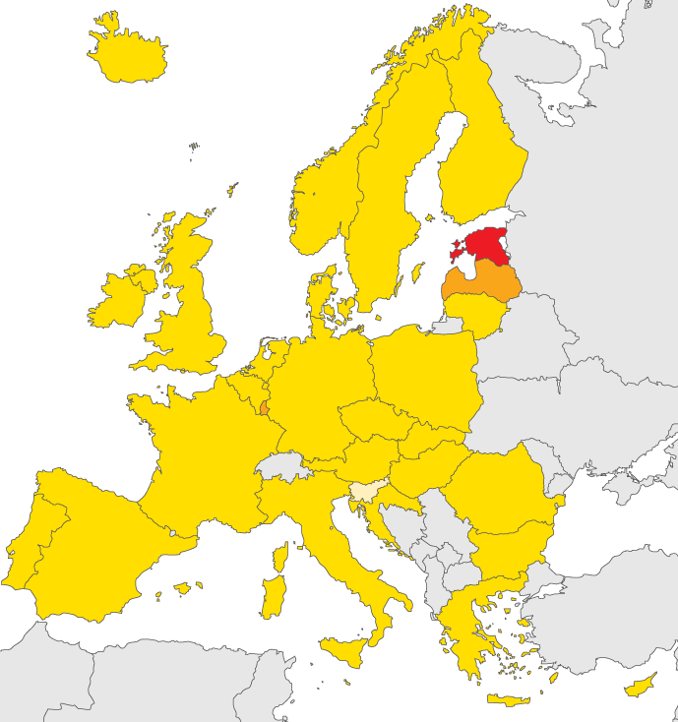
New HIV diagnoses, 2014, EU/EEA
Rate per 100 000 population
< 2
2 to <10
10 to <20
> 20
Not included or
not reporting
EU/EEA rate 5.9 per 100 000*
Non-visible countries
Liechtenstein
Luxembourg
Malta
* EU rate adjusted for reporting delay is 6.4 per 100 000
Notes:
Narration
In the EU there were approximately 6 new diagnoses per 100,000 population in 2014, representing almost 30,000 individuals.
Additional information
Reporting countries/Number of countries 31/31
Total number of HIV diagnoses 29 992
Rate per 100 000 population (adjusted rate) 5.9 (6.4)
Male-to-female ratio 3.3
Source: ECDC/WHO (2015) HIV/AIDS Surveillance in Europe 2014

Slide 7
Rate of reported HIV diagnoses, by year of diagnosis
WHO European Region, 2005-2014
Notes:
Narration
Overall, data shows that the HIV epidemic is stable in Western and Central Europe as you can see by the flat green lines on this chart, while at the same time escalating in Eastern Europe and Central Asia: as indicated by the darker blue line you can see it has risen year on year since 2005.
In Western Europe, despite an overall decrease in the number of new infections many areas have seen a rise in HIV incidence in men who have sex with men (MSM).
Source: WHO/ECDC HIV /AIDS Surveillance in Europe 2014

Slide 8
Rate of reported HIV diagnoses, by year of diagnosis
EU/EEA, 1984–2013
Source: ECDC/WHO (2014). HIV/AIDS Surveillance in Europe, 2013
Notes:
Narration
This more recent stabilisation of the HIV epidemic in Western Europe is occurring on a background of years of significant increases.
Source: WHO/ECDC HIV /AIDS Surveillance in Europe 2014

Slide 9
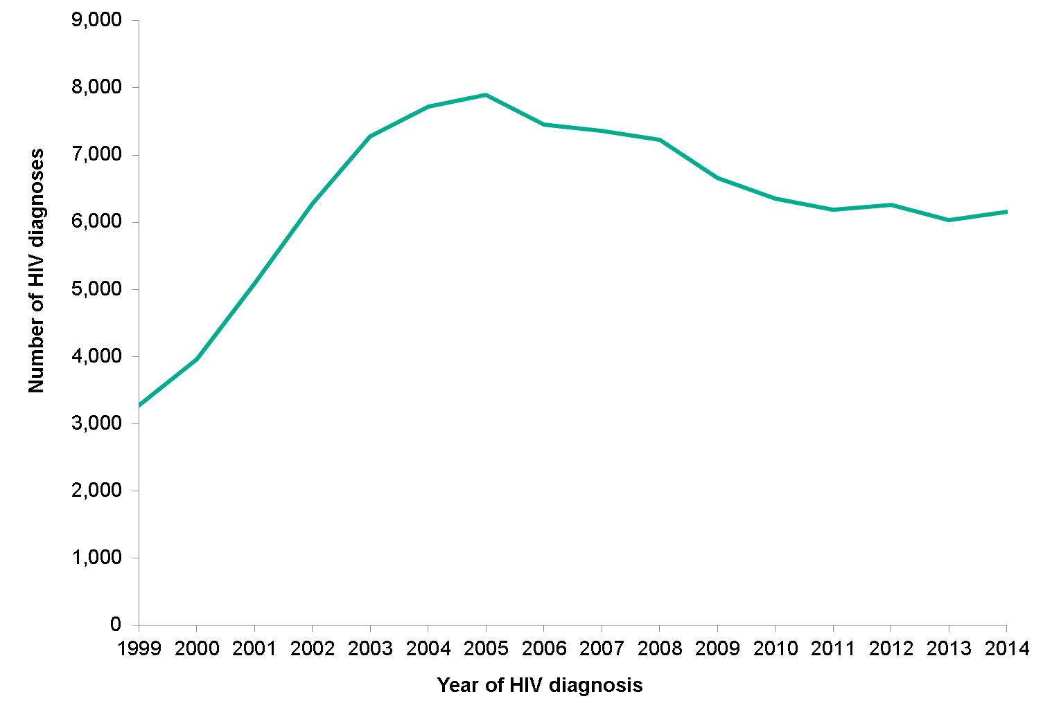
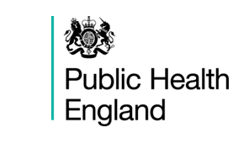
Annual new HIV diagnoses, UK, 1999-2014
Notes:
Narration:
In 2014, 6,150 people (4,610 men and 1,540 women) were newly diagnosed with HIV in the UK.
New diagnoses have continued to decline since a peak in 2005 (7,892), largely due to a decrease in people newly diagnosed with HIV who acquired their infection abroad.
Source:
Public Health England - HIV in the UK: 2015 report
https://www.gov.uk/government/statistics/hiv-in-the-united-kingdom

Slide 10
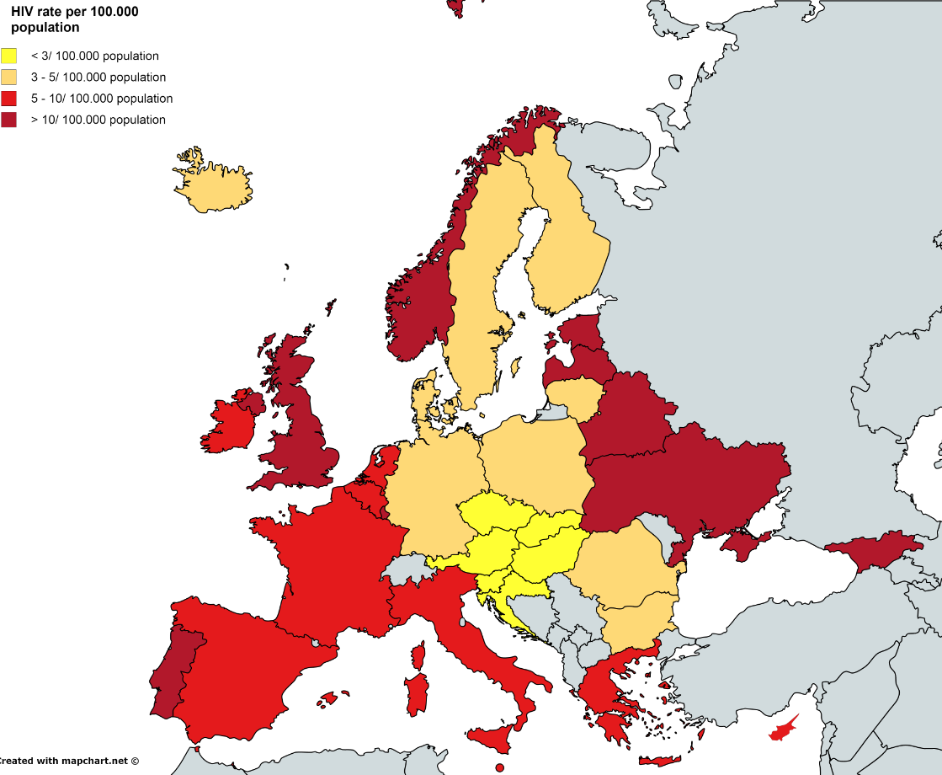
HIV prevalence, 2014, EU/EAA
Notes:
Narration
This slide shows the reported HIV seroprevalence in countries across Europe.
Source: ECDC Surveillance report 2014

Slide 11
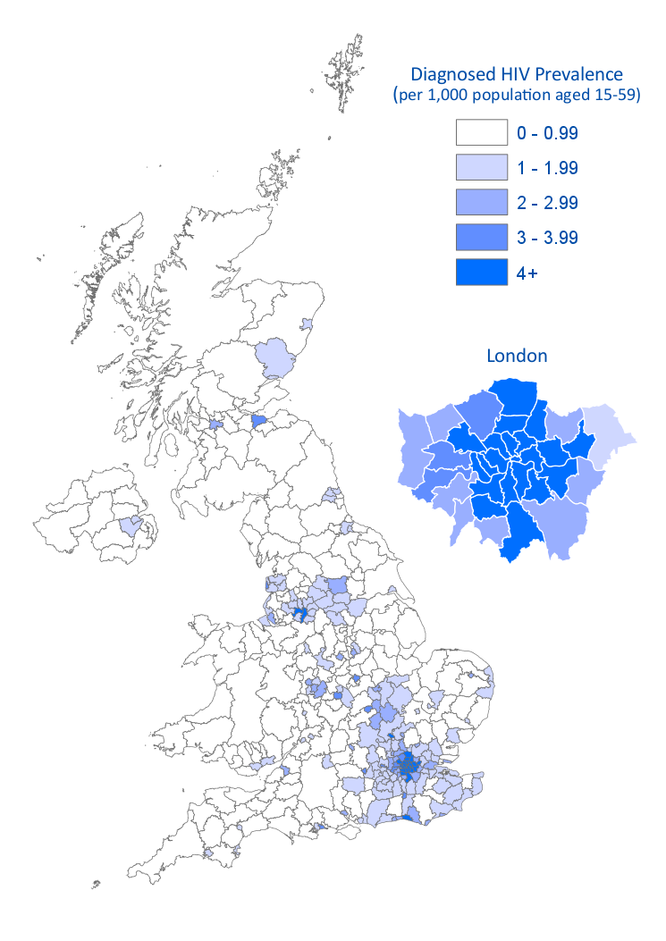

Prevalence of diagnosed HIV infection by area of residence among population aged 15-59 years: UK, 2014
Notes:
Narration
In 2014, one in five (21%) English local authorities had a diagnosed prevalence above the 2 per 1,000 threshold recommended in national guidelines as the cut-off for expanded HIV testing into new registrants in general practice and general hospital admissions.
In London all but one of the 33 local authorities had prevalence above this threshold.
Outside London, the five local authorities with the highest prevalence in order were: Brighton and Hove, Manchester, Salford, Luton and Blackpool.
Source:
Public Health England - HIV in the UK: 2015 report
https://www.gov.uk/government/statistics/hiv-in-the-united-kingdom

Slide 12
HIV diagnoses, by mode of transmission, 2005-2014,
WHO European Region
Notes:
Narration
This slide demonstrates the number of new HIV diagnoses each year within the WHO European region, broken down into transmission groups. The number of new HIV diagnoses is rising in both MSM (men who have sex with men) and heterosexuals.
(The slight dip in 2104 is likely to be due to reporting delay for 2014 data)
Source: ECDC/WHO (2015) HIV/AIDS Surveillance in Europe 2014

Slide 13
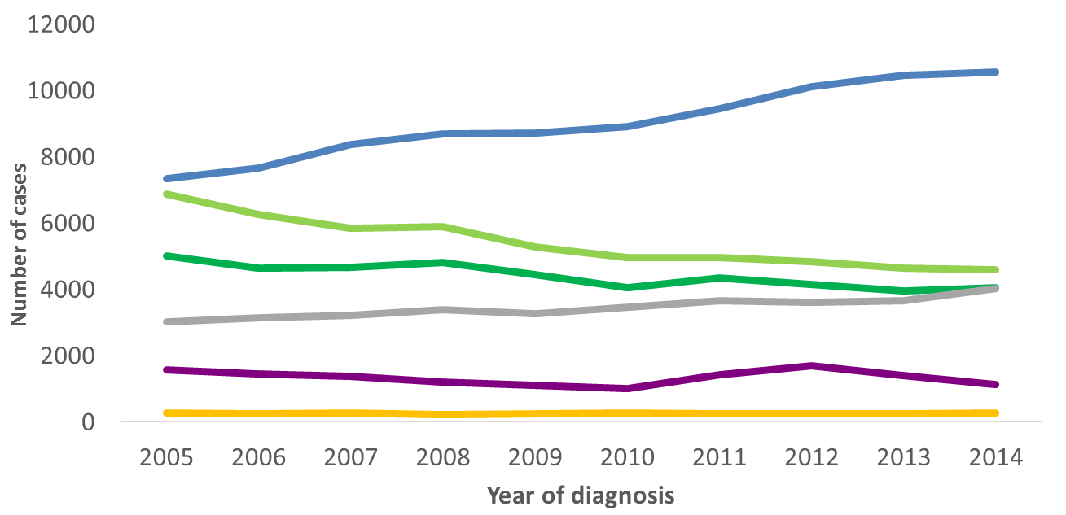
HIV diagnoses, by mode of transmission,
2005-2014, EU/EEA
Sex between men
Heterosexual (women)
Heterosexual (Men)
Other/
undetermined
Injecting drug use
Mother-to-child transmission
Data is adjusted for reporting delay. Cases from Estonia and Poland excluded due to incomplete reporting on transmission mode during the period; cases from Italy and Spain excluded due to increasing national coverage over the period.
Source: ECDC/WHO (2015). HIV/AIDS Surveillance in Europe, 2014
Notes:
Narration
In the EU the number of new HIV diagnoses is rising significantly in MSM (men who have sex with men), accounting for 40% of all transmissions in 2014, but the number is falling in heterosexuals.
Additional information
In 2014
Transmission mode (%)
Sex between men 42
Heterosexual 33
Injecting drug use 4
Mother to child transmission <1
Unknown 20
Source: ECDC/WHO (2015) HIV/AIDS Surveillance in Europe 2014

Slide 14
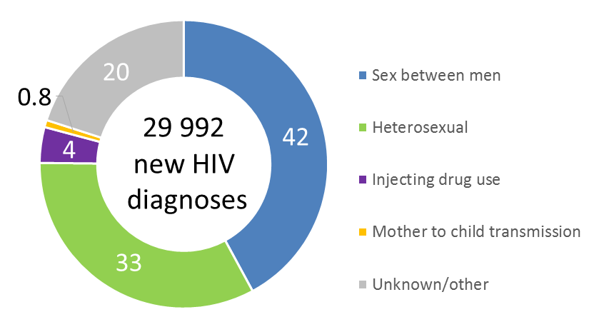
Percentage of HIV diagnoses, by route of transmission,
2014, EU/EEA
Source: ECDC/WHO (2015). HIV/AIDS Surveillance in Europe, 2014
Notes:
Note: this slide is an alternative way of presenting the data shown on the preceding slide as cross sectional data for 2014
Narration
In the EU the majority of new transmissions are in MSM (men who have sex with men); representing more than half of those cases with a reported transmission route.
Source: ECDC/WHO (2015) HIV/AIDS Surveillance in Europe 2014

Slide 15
Percentage of new HIV diagnoses with known mode of transmission, by transmission route and country, EU/EEA, 2014 (n = 24,083)
Notes:
Note: this slide shows the previous data at country level for those where the transmission route is reported
Narration
If used as a stand alone slide (i.e. if you do not use preceding slide)
In the EU the majority of new transmissions are in MSM (men who have sex with men); representing more than half of those cases with a reported transmission route.
If used as a follow on from previous slide
This slides demonstrates the data for those cases where the transmission route is reported at a country level; as you can see there is considerable variation across the region; however for some countries this may represent under reporting by risk groups.
Source: WHO/ECDC HIV /AIDS Surveillance in Europe 2014

Slide 16
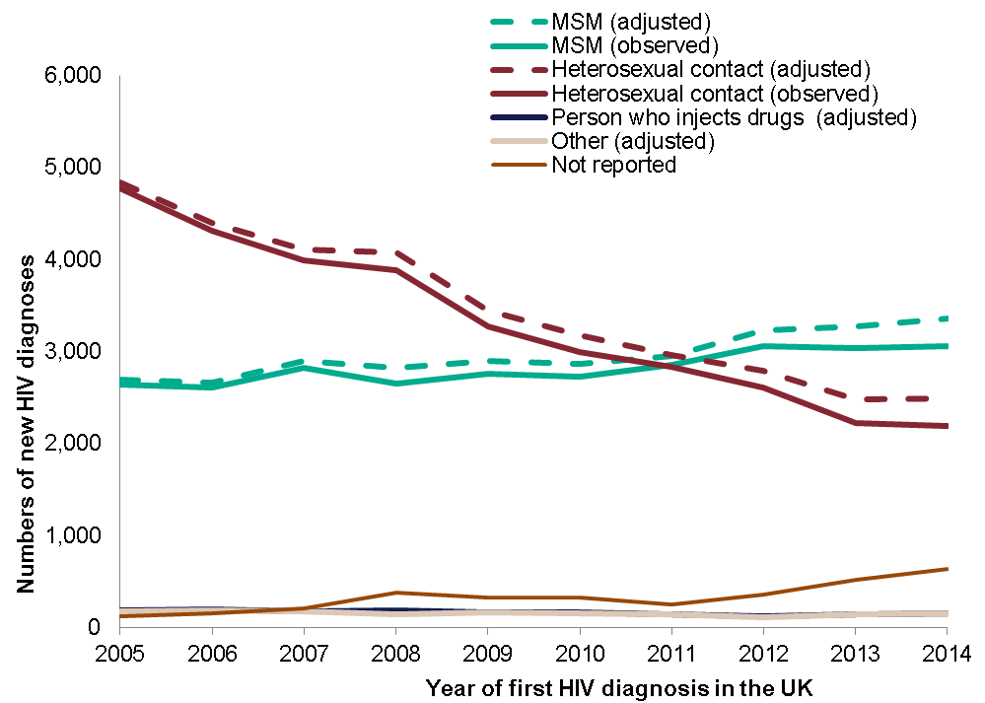
New HIV diagnoses by exposure group, United Kingdom, 2005-2014
Notes:
Narration
In 2014 of the 6,150 new diagnosis the overwhelming majority (>95%) acquired HIV through sexual contact.
After adjusting for missing risk information, people newly diagnosed with HIV who acquired it through heterosexual contact accounted for 35% (n=2,186) of new infections, whilst 49% (n=3,055) were among men who have sex with men (MSM).
New HIV diagnoses among people who inject drugs, and through other routes have remained low over time, accounting for 150 new diagnoses each in 2014.
Source:
Public Health England - HIV in the UK: 2015 report
https://www.gov.uk/government/statistics/hiv-in-the-united-kingdom

Slide 17
1. General profile of the HIV epidemic across Europe
2. Why Test for HIV?
3. Consequences of late diagnosis
4. Missed Opportunities
6. HIV testing strategies – including indicator condition guided HIV testing
5. Barriers to testing / Frequently raised concerns
Notes:
Narration
So why is it so important to increase testing for HIV?

Slide 18
1. General profile of the HIV epidemic across Europe
2. Why Test for HIV?
3. Consequences of late diagnosis
4. HIV testing strategies – including indicator condition guided HIV testing
Notes:
Narration
So why is it so important to increase testing for HIV?

Slide 19



Why test for HIV?
Direct health benefits to the individual when able to access effective antiretroviral therapy
Decreased morbidity
Decreased mortality
Reduced onward transmission to partners
Risk behaviour modification
Effective treatment results in an undetectable viral load, and means they are considered to be non-infectious to sexual partners
Reduced healthcare costs
Avoiding the complications associated with untreated HIV, and thereby avoiding the resulting healthcare costs
Notes:
Narration
There are three main reasons why it is important to diagnose HIV.
The first is the direct health benefit to the individual. Once diagnosed they can access very effective treatment and thereby avoid significant morbidity and death.
The second is to reduce onward transmission to partners. Once a person is diagnosed they typically modify their behaviour to reduce risk. Furthermore, once an individual starts treatment and achieves an undetectable viral load they are considered to be non-infectious to sexual partners.
Early diagnosis also reduces healthcare costs as it avoids the morbidity associated with untreated HIV, and thereby avoiding the resulting healthcare costs of treating any complications of untreated HIV.

Slide 20
Why test for HIV?
Increasing HIV testing should lead to increased numbers of HIV diagnoses.
This in turn should result in decreases in:
individuals living with undiagnosed HIV
individuals presenting with late stage disease
Notes:
Narration
So, increasing HIV testing should result in an increase in the number of HIV diagnoses, which in turn should results in both fewer people being unaware of their status and a decrease in the number of people presenting with late disease.

Slide 21
Reducing the number of people living with undiagnosed HIV
Notes:
Narration
First let’s look at the data on the proportion of people who have HIV but are unaware of their status.

Slide 22
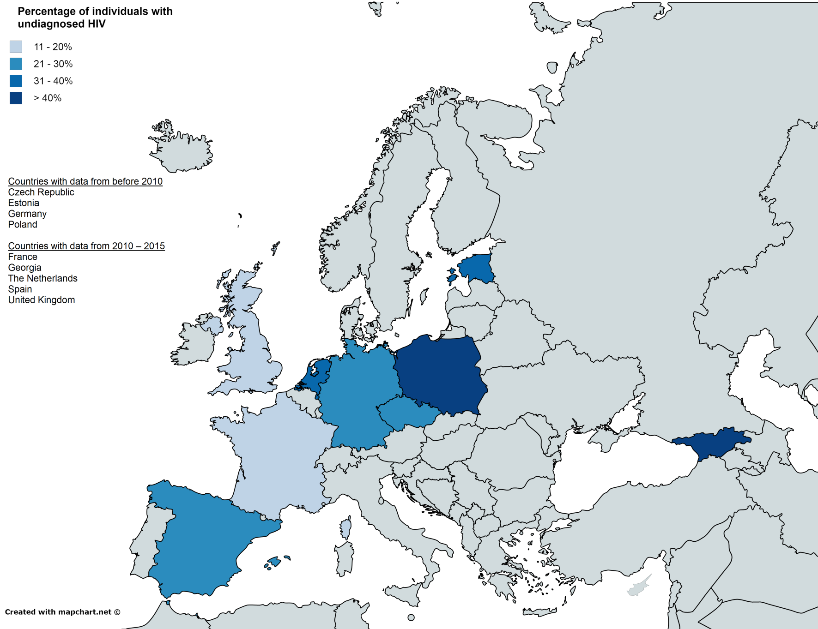
Notes:
Narration
Studies have shown that the majority of new HIV transmissions may originate from individuals who are unaware of their HIV infection. This may be due to higher infectiousness (because of elevated viral load at the time of HIV seroconversion), and more frequent high-risk practices among undiagnosed than diagnosed HIV-infected individuals. Undiagnosed individuals are also at risk of delayed diagnosis and thus might not benefit from timely initiation of ART. Therefore, screening for the undiagnosed HIV-positive individuals is key to turning the tide on HIV transmission and reduce mortality
It is estimated that one-third of individuals living with HIV in the EU are unaware of their HIV status and that in some Eastern European countries, this proportion rises to 50%. The level of those who are undiagnosed varies between different high risk groups, i.e. MSM or PWID, with certain groups more likely to be affected.
In this map, we can see that the darker shades with the higher percentage of undiagnosed trend toward Eastern Europe. However, data is still limited or outdated in many countries therefore the proportion of undiagnosed is still widely unknown.
Source: Supervie V. et al. The undiagnosed HIV epidemic in France and its implications for HIV screening strategies. AIDS, 2014 ; 28(12): 1797-1804.

Slide 23
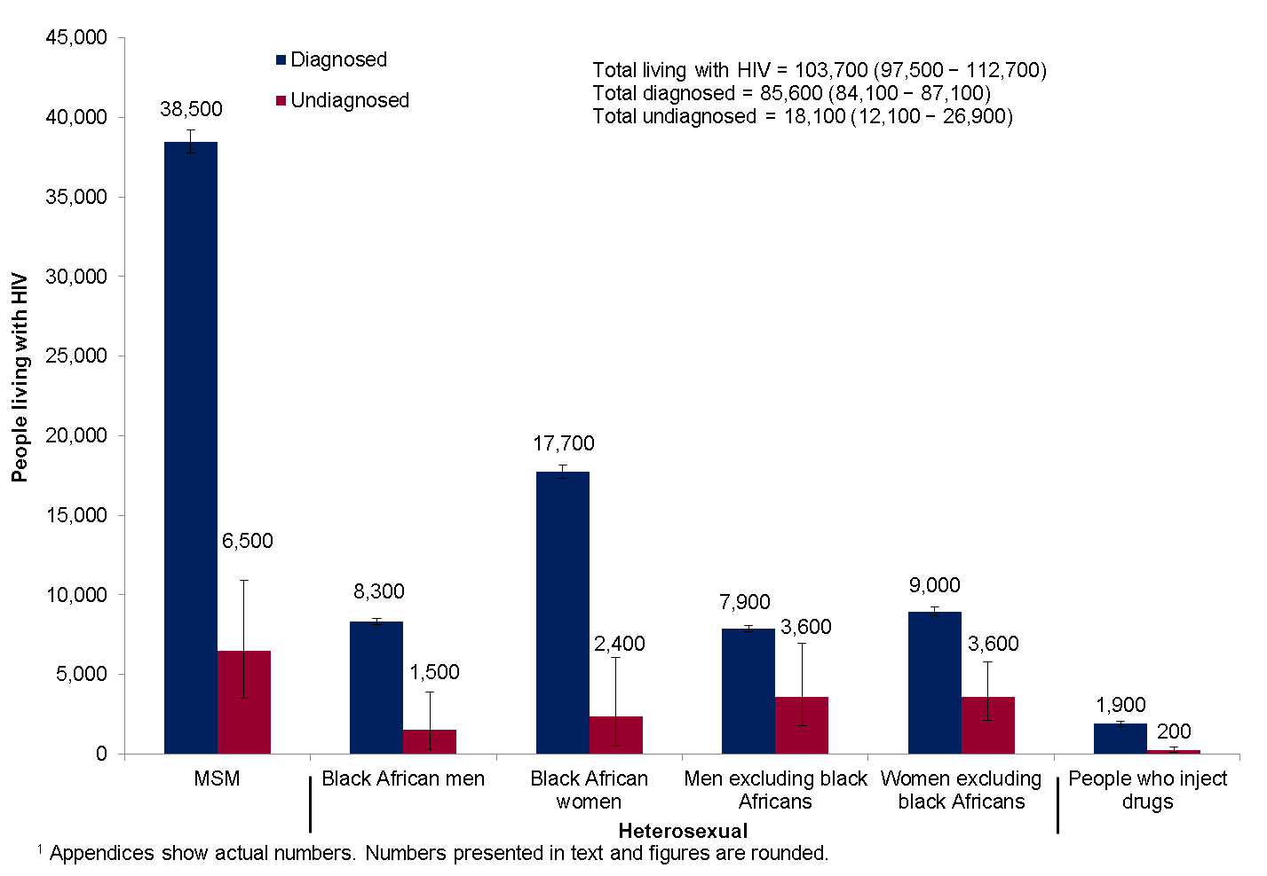
Estimated number of people living with HIV (both diagnosed and undiagnosed): United Kingdom, 2014
Notes:
Narration
An estimated 103,700* people were living with HIV in the UK in 2014.
The overall prevalence was 2.3 per 1,000 population aged 15-44 years**.
18% (18,100) of people were estimated to be living with HIV and unaware of their infection. They remain at risk of passing on their infection if having sex without condoms.
Source:
Public Health England - HIV in the UK: 2015 report
https://www.gov.uk/government/statistics/hiv-in-the-united-kingdom
*95% credible interval 97,500-112,700
** 1.7 per 1,000 women and 2.8 per 1,000 men

Slide 24
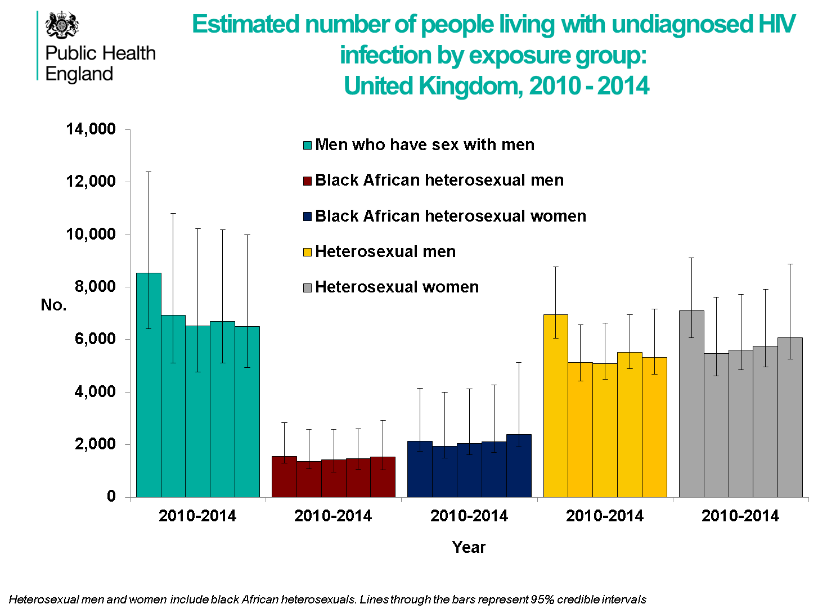

Estimated number of people living with undiagnosed HIV
infection by exposure group: United Kingdom, 2010-2014
Number of people living with undiagnosed HIV
Notes:
Narration
Estimates of the number of people living with undiagnosed HIV have remained stable since 2010, across all exposure groups.
Source:
Public Health England - HIV in the UK: 2015 report
https://www.gov.uk/government/statistics/hiv-in-the-united-kingdom

Slide 25
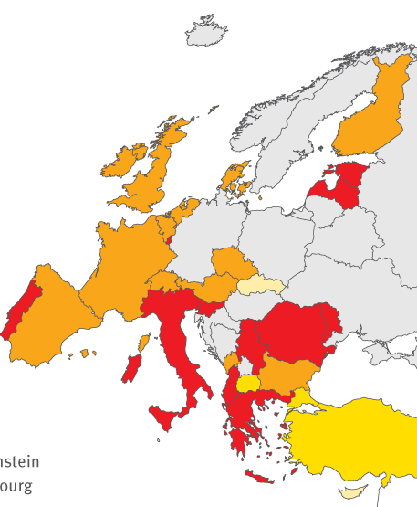
Proportion of HIV cases diagnosed late (CD4<350 cells/mm³)
2014, EU/EEA
< 30%
30 to <40%
40 to 50%
> 50%
Not included or
not reporting
Non-visible countries
Liechtenstein
Luxembourg
Malta
*Among cases with CD4 count at diagnosis reported
Notes:
Narration
In 2014 in the 22 countries across Europe (EU/EEA) with available data, almost half; 47%, of all HIV cases were diagnosed late with a CD4 count less than 350. More than a quarter of these ; 27%, had advanced HIV infection ; that is a CD4 count less than 200 at diagnosis. All these individuals are therefore at risk of increased morbidity and mortality. However you can see on this slide there is considerable variation between countries.
Additional data
NOTE this table is 2013 DATA, slide is 2014
EU countries Late presentation for 2013
Austria 45% Italy 58%
Belgium 43% Latvia 54%
Bulgaria 47% Luxembourg 55%
Cyprus 19% Portugal 58%
Czech Republic 26% Romania 34%
Denmark 48% Slovakia 21%
Estonia 52% Slovenia 58%
Finland 57% Spain 48%
France 46% The Netherlands 43%
Greece 55% United Kingdom 42%
Ireland 50%
EU countries Late presentation for 2013
Albania 71% Montenegro 86%
Armenia 53% Serbia 58%
Azerbaijan 50% The Former Yugoslav 8%
Republic of
Macedonia
Bosnia and 62% Tajikistan 55%
Herzegovina
Georgia 66% Switzerland 49%
Israel 46% Turkey 50%
Kyrgyzstan 56% Ukraine 51%
Source: ECDC/WHO (2015) HIV/AIDS Surveillance in Europe 2014

Slide 26
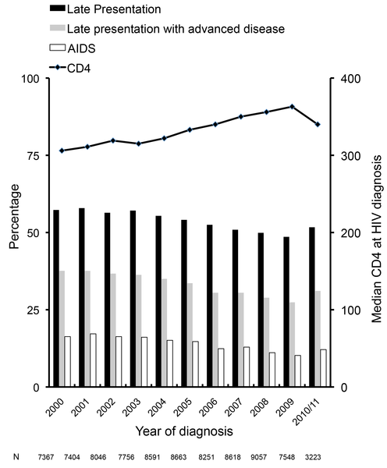
Late Diagnosis in Europe: Late presentation and CD4 count at HIV diagnosis 2000 – 2011 (COHERE)
Notes:
Narration
This shows data from the COHERE cohort of the proportion of individuals presenting late between 2000 and 2011. Although there has been a small downward trend over the years, data shows that very little has changed in terms of reducing late diagnosis
Source: Mocroft A et al., Risk Factors and Outcomes for Late Presentation for HIV-Positive Persons in Europe: Results from the Collaboration of Observational HIV Epidemiological Research Europe Study (COHERE). PLoS Med, 2013

Slide 27
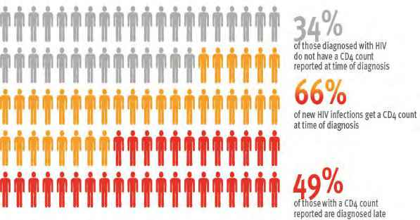


Late diagnosis in Europe, 2013
13
Notes:
NEED 2014 version, and WHO European region
Narration
A significant proportion of individuals diagnosed with HIV in Europe do not have a CD4 count measured at diagnosis. Of those who do, half (49%) were diagnosed late , that is had a CD4 count below 350 cells/uL
Source:

Slide 28
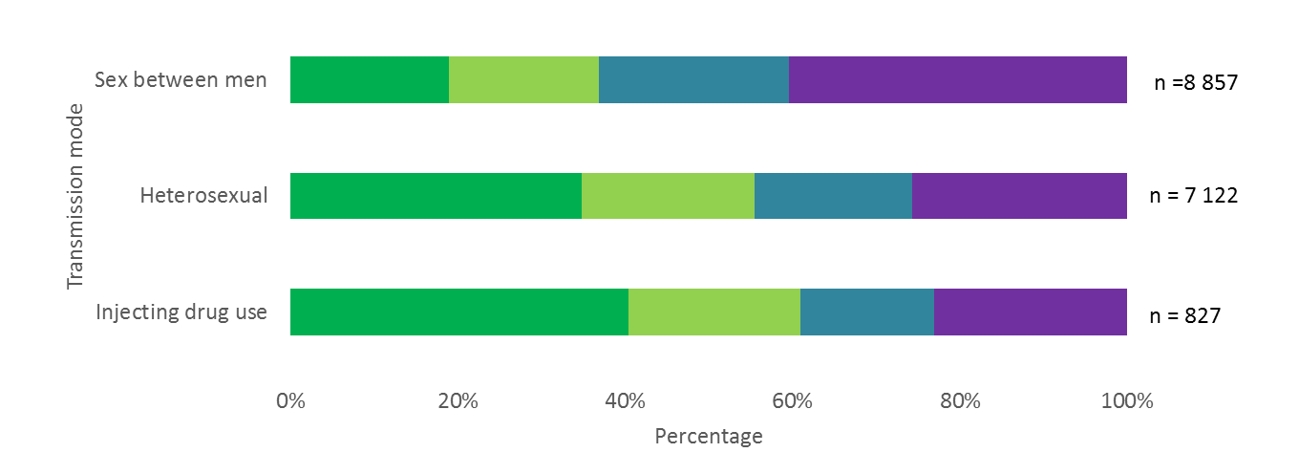
New HIV diagnoses, by CD4 cell count at diagnosis and transmission mode, EU/EEA, 2014
< 200 cells/mm³
200 to <350 cells/mm³
350 to <500 cells/mm³
>500 cells/mm³
Source: ECDC/WHO (2015). HIV/AIDS Surveillance in Europe, 2014
Notes:
Narration
As you can see from this slide, late presentation affects some groups more than others with a greater proportion of PWID (people who inject drugs) and heterosexuals presenting at a late stage compared to MSM.
Source: ECDC/WHO (2015) HIV/AIDS Surveillance in Europe 2014

Slide 29
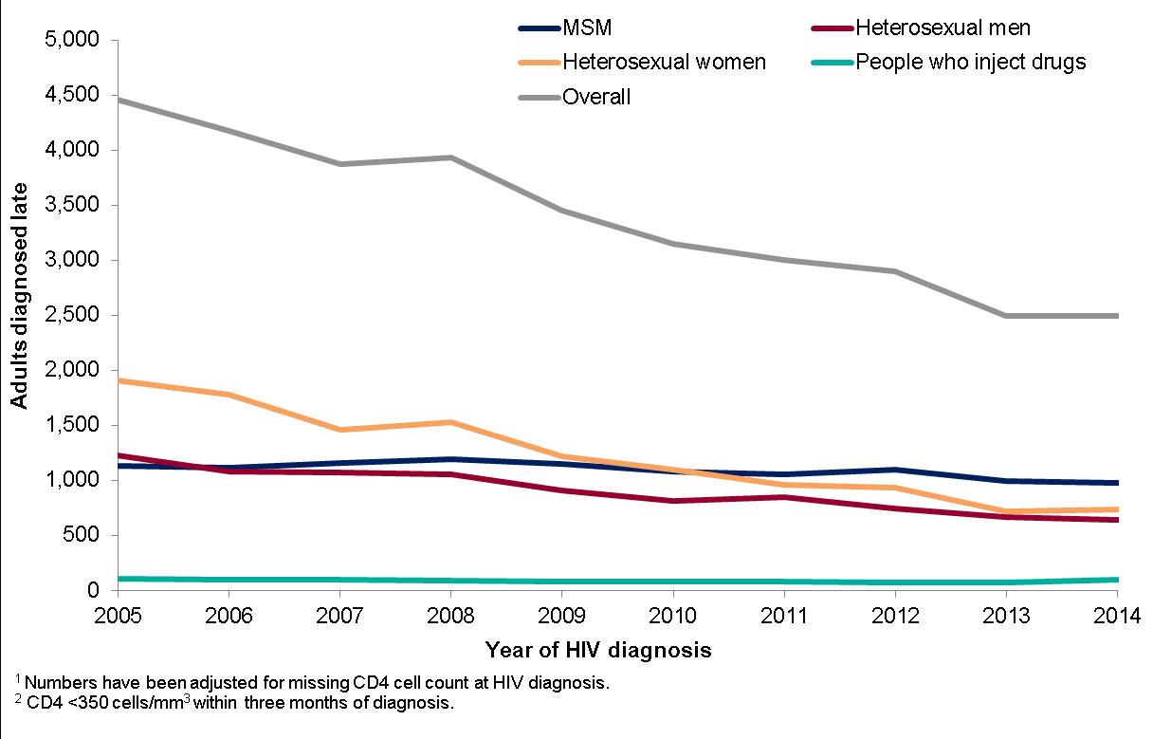
Late HIV diagnosis by exposure category: United Kingdom
2004-2014
Notes:
Narration
Over the past decade the number of people diagnosed with HIV at a late stage of infection (CD4 <350 cells/mm³) has decreased from 3,600 in 2005 to 1,980 in 2014.
The largest decline was seen among heterosexual women from 1,905 in 2005 to 738 in 2014.
Source:
Public Health England - HIV in the UK: 2015 report
https://www.gov.uk/government/statistics/hiv-in-the-united-kingdom

Slide 30
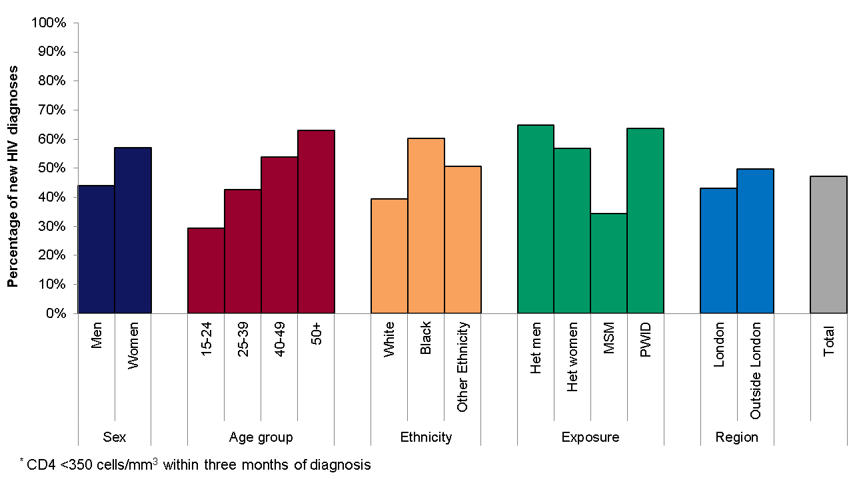

Late HIV diagnosis: Proportion* of adults diagnosed with a
CD4 count <350 cells ,UK, 2014
Notes:
Narration
In 2014, there was considerable variation in late diagnosis by exposure group and ethnicity, with a higher proportion of black African people (58%), heterosexual men (61%) and PWID (65%) diagnosed at a late stage of infection.
London had the lowest proportion of people diagnosed late (33%) compared to the North of England (48%) and in Wales and Northern Ireland, where late diagnosis was >50%.
Source:
Public Health England - HIV in the UK: 2015 report
https://www.gov.uk/government/statistics/hiv-in-the-united-kingdom
PWID: people who inject drugs

Slide 31

Late diagnosis in <COUNTRY>, <YEAR>
Please use this template if don’t have access to a country level data slide.
See notes.
10%
Proportion without a reported CD4 count at diagnosis
42%
Proportion diagnosed with a CD4 count >350 cells/uL
48%
Proportion with a CD4 count indicating late diagnosis
28%
Proportion with a CD4 count indicating advanced disease
Notes:
***This slide can be adapted using your own country level data if required***
Instructions:
Replace <COUNTRY>, <YEAR> with correct details
Click on the boxes with the percentages (to the right) and edit the data to match the findings from your country.
3. To change the colours of the diagram to match your percentages, right click each individual figure and select Format Picture. Then change the Fill to the desired colour.
4. To move the red line, click and drag the yellow line to desired location.
5. Delete the shaded text box in the upper right corner

Slide 32
Late HIV diagnosis, <COUNTRY, YEAR>
Please use this template if don’t have access to a country level data slide. See notes
In <YEAR>
<X%> of individuals diagnosed with HIV infection presented late (CD4 count <350 cells/uL)
<Y%> presented very late (CD4< 200 cells/uL)
www.testingweek.eu
www.hiveurope.eu
Notes:
Replace the <italicised text> with the correct details and data, delete the text in italics and the shaded box
The data on late diagnosed HIV infections and people diagnosed with advanced HIV disease can be found, where available on the link below. Use this data to over write X and Y above
http://ecdc.europa.eu/en/publications/Publications/hiv-aids-surveillance-in-Europe-2014.pdf
Narration
In <Country> in <year> X% of people presented with a CD4 count less than 350, that is with late disease. Y% presented very late with a CD4 count below 200 cells.

Slide 33
1. General profile of the HIV epidemic across Europe
2. Why Test for HIV?
3. Consequences of late diagnosis
4. Missed Opportunities
6. HIV testing strategies – including indicator condition guided HIV testing
5. Barriers to testing / Frequently raised concerns
Notes:
Narration
There are a number of serious consequences of late HIV diagnosis

Slide 34
1. General profile of the HIV epidemic across Europe
2. Why Test for HIV?
3. Consequences of late diagnosis
4. HIV testing strategies – including indicator condition guided HIV testing
Notes:
Narration
There are a number of serious consequences of late HIV diagnosis

Slide 35
Consequences of late diagnosis
Increased morbidity and mortality
Increased onward transmission
Increased healthcare costs
Notes:
Narration
Three major consequences of being diagnosed with a CD4 count below 350 (that is at a ‘late’ stage) are increased morbidity and mortality, more onward transmission and higher healthcare costs

Slide 36
Increased mortality associated with late diagnosis
www.testingweek.eu
www.hiveurope.eu
Notes:
Narration
Up to a third of all HIV-related deaths are estimated to be a consequence of late diagnosis; that is patients are diagnosed too late for HIV treatment to be effective
Source: Adler A, Mounier-Jack S & Coker J. Late diagnosis of HIV in Europe: definitional and public health challenges AIDS Care 21, 03 (2009) 284-293.

Slide 37
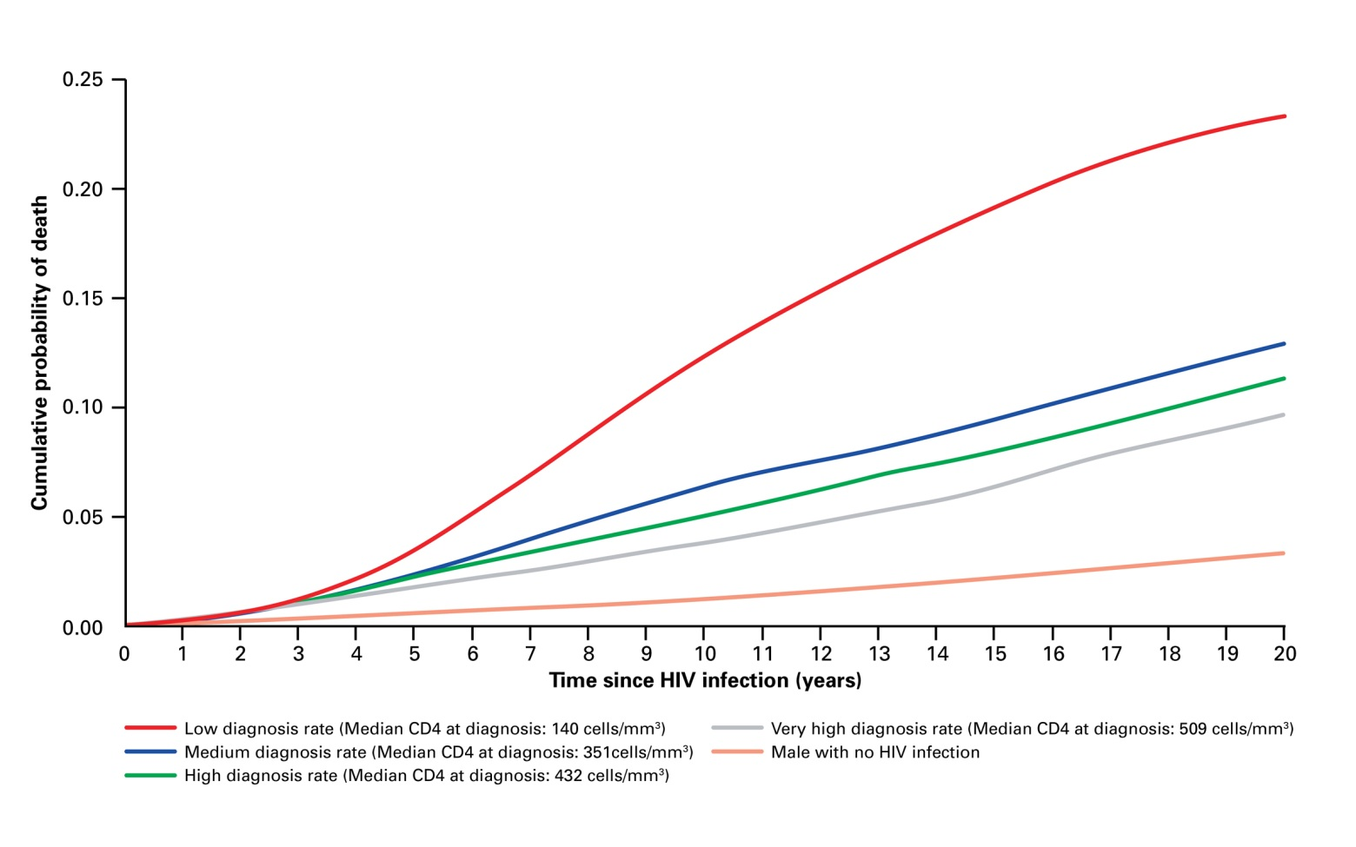
Cumulative probability of death of people with HIV according to timing of diagnosis
www.testingweek.eu
www.hiveurope.eu
Notes:
Narration
This graph demonstrates the relationship between mortality and the stage at which HIV is diagnosed. The red line is those diagnosed with an extremely low CD4 count and can be compared to increasing CD4 counts, moving down towards the bottom line which represents HIV negative men.
Source: Nakawaga F et al. Projected life expectancy of people with HIV according to timing of diagnosis. AIDS 2011, 25.

Slide 38
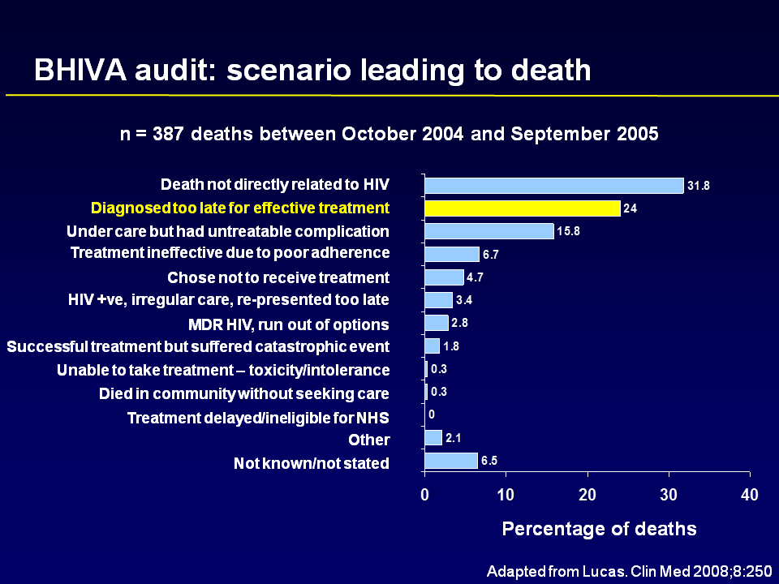
Causes of death: United Kingdom, Oct 2004 – Sep 2005
Notes:
Narration
A UK-wide audit revealed in a 12 month period that a quarter of people who had died with HIV, died because they were diagnosed too late to received effective treatment.
Source: Lucas SB, Curtis H, Johnson MA. National review of deaths among HIV-infected adults. Clin Med (Lond) 2008; 8:250-2

Slide 39
Increased risk of transmission of HIV
  Evidence shows that when individuals are diagnosed with HIV infection they decrease their risk behaviour.
  HIV patients taking effective treatment are very unlikely to transmit HIV.
  People who remain undiagnosed do not have the advantage of either of these two factors.
Notes:
Narration
Those individuals who are diagnosed at a late stage of disease spend a prolonged period being unware of their HV status and are therefore at greater risk of transmitting HIV to other partners.
We know that when people are diagnosed with HIV they take steps to reduce the risk of onward transmission, by reducing the number of sexual partners and using condoms.
When individuals with HIV infection take effective treatment – that is antiretroviral therapy which reduces the viral load in their blood – they are very unlikely to transmit HIV
People who are undiagnosed clearly cannot benefit from either of these preventions
Sources: Moreno S, Mocroft A & Monfonte A Review: Medical and Societal consequences of late presentation Antiviral Therapy, 2010, 15, suppl 1; 9-15.
Marks G, Crepaz N and Janssen RS, Estimating sexual transmission of HIV from persons aware and unaware that they are infected with the virus in the US. AIDS 2006, 20:1447–1450.
Hall HI et al. HIV Transmission Rates from persons living with HIV who are aware and unaware of their infection, United States AIDS 2012.
Cohen MS, Chen YQ, McCauley M, Gamble T, Hosseinipour MC, Kumarasamy N, et al. Prevention of HIV-1 infection with early antiretroviral therapy. N Engl J Med. 2011;365:493–505.

Slide 40
Undiagnosed HIV and onward transmission
USA modelling data
Notes:
Narration
In the US it is estimated that 25% of people living with HIV are unaware of their status. Modelling data indicates that this 25%, with undiagnosed HIV (shown in the column on the left in red) account for 54% of new transmissions, as we see in red in the column on the right. This transmission rate is 3 and a half times higher than that of those individuals who are aware of their HIV status
Additional information.
The estimates are based on :
1) 33% of the aware group are at low risk of transmitting HIV because of low/undetectable viral load; 2) 57% relative reduction in the prevalence of unprotected anal and vaginal intercourse (UAV) with at-risk partners in persons aware (compared to unaware) they have HIV
3) assumed differences in the average number of at-risk UAV partners in each awareness group (ranging from equal to twice as many in the unaware group).
The estimate range is based on assumptions regarding partners
54%: assuming no difference in average number of at-risk UAV partners between groups
70%: assuming twice as many at-risk UAV partners in the unaware group
These results indicate that the HIV/AIDS epidemic can be lessened substantially by increasing the number of HIV-positive individuals who are aware of their status.
Sources: Marks G, Crepaz N, Janssen RS (2006) Estimating sexual transmission of HIV from persons aware and unaware that they are infected with the virus in the USA. AIDS 20:1447-1450
Campsmith ML, Rhodes PH, Hall HI, Green TA. Undiagnosed HIV prevalence among adults and adolescents in the United States at the end of 2006. J Acquir Immune Defic Syndr. 2010;53:619-624.

Slide 41
Increased healthcare costs
Medical costs associated with late diagnosis are up to 3.7 times as high as those associated with timely diagnosis and treatment
Even after 7 - 8 years, late diagnosis is still associated with higher cumulative expenses
Studies suggest that HIV testing remains cost-effective as long as the undiagnosed HIV prevalence is above 0.1%
www.testingweek.eu
www.hiveurope.eu
Notes:
Narration
Late diagnosis also impacts significantly on healthcare costs. This is in large part due to the morbidity associated with undiagnosed HIV, causing many individuals to repeatedly access healthcare with illness which are HIV related, but not recognised as such.
These costs are nearly four times higher than healthcare costs for individuals diagnosed and treated in a timely manner.
This disparity continues for a prolonged period, reflecting a combination of the related poorer HIV treatment response at late stage disease, and also in some cases the consequences of the related condition.
Currently it is considered that an HIV testing programme will be cost effective if the undiagnosed HIV prevalence is at least 0.1% or 1 per 1000.
Sources: Krentz, HB & Gill MJ. Cost of medical care for HIV-infected patients within a regional population from 1997 to 2006. HIV Medicine (2008), 9, 721–730.
Fleishman JA, Yehia BR, Moore RD, Gebo KA& HIV Research Network . The Economic Burden of Late Entry Into Medical Care for Patients With HIV Infection. Med Care. 2010 December ; 48(12): 1071–1079.

Slide 42
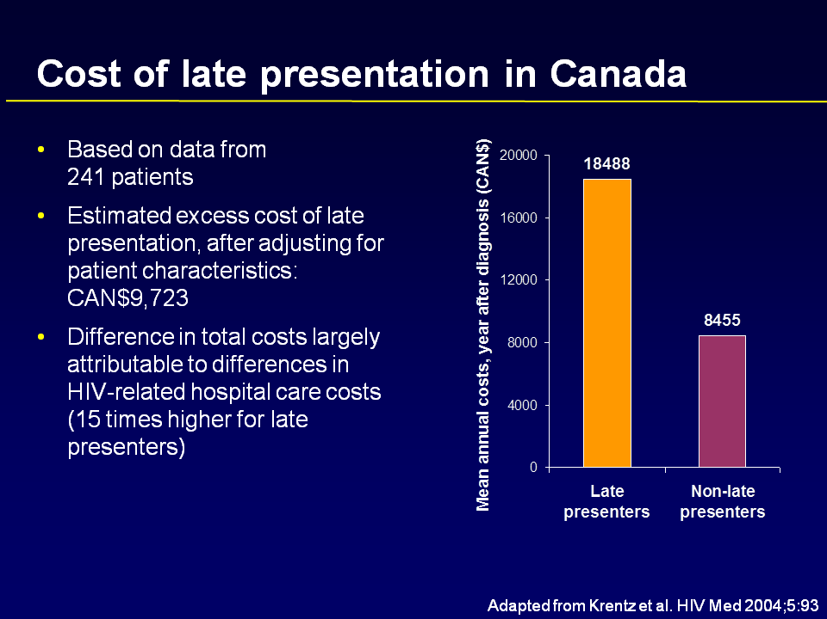
Increased healthcare costs
Notes:
Narration
This slide shows the mean annual HIV healthcare costs for the year after diagnosis in Canada. It shows the direct costs in the first year of care for those diagnosed late are twice that compared to those with a timely diagnosis
Source: Krentz HB, Auld MC, Gill MJ. The high cost of medical care for patients who present late (CD4 <200 cells/microL) with HIV infection. HIV Med 2004; 5:93-8

Slide 43
Benefits of early diagnosis: access to treatment and care
Improved treatment response
Decreased morbidity and mortality
Decreased onward transmission
Decreased healthcare costs
Impacts societal costs
Earlier HIV diagnosis is one of the most important factors associated with better life expectancy
The benefits of early HIV testing on morbidity and mortality:
“With timely diagnosis, access to a variety of current drugs and good lifelong adherence, people with recently acquired infections can expect to have a life expectancy which is nearly the same as that of HIV negative individuals.”
www.testingweek.eu
www.hiveurope.eu
Notes:
Narration
The primary benefit of early diagnosis is the timely access to treatment and care. This affords the opportunity for
improved treatment response, which is related to the CD4 count at treatment initiation
reduced morbidity and mortality, avoiding HIV related infections and malignancies
decreased transmission via treatment as prevention or TasP producing an undetectable viral load and therefore reduced infectiousness
decreased healthcare costs by avoidance of HIV related morbidity
and related societal cost by reduction in state support and improved productivity potential
We know that timely HIV diagnosis is the key to improved life expectancy and that this approaches normal predicted life expectancy for individual s with HIV infection when the diagnosis and access to treatment and care is timely.
Source:
Quote: Nakagawa F, May M, Phillips A. Life expectancy living with HIV: recent estimates and future implications. Curr Opin Infect Dis. 2013 Feb;26(1):17-25. doi: 10.1097/QCO.0b013e32835ba6b1.

Slide 44
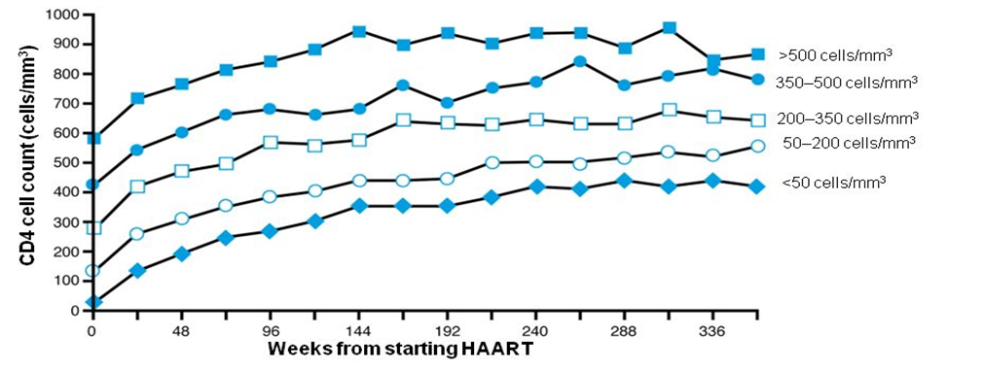
Improved treatment response with anti-retroviral (ARV) therapy
CD4 at start of therapy impacts on immunological outcome
Notes:
Narration
Patients who start ARV (antiretroviral therapy) with a higher CD4 count have a greater chance of improving their CD4 count to normal or near normal levels. The top line represents individuals starting ARVs with a CD5 count above 500, the bottom line is those with a CD4 count less than 50. A CD4 count greater then 350 at 4 years is associated with significantly higher survival). Current WHO guidelines (and many National guidelines) now recommend all individuals should commence treatment regardless of their CD4 count. (Add in here <COUNTRY> policy)
Sources:
Gras L, Kesselring AM, Griffin JT, van Sighem AI et al., CD4 cell counts of 800 cells/mm3 or greater after 7 years of highly active antiretroviral therapy are feasible in most patients starting with 350 cells/mm3 or greater. J Acquir Immune Defic Syndr 2007 Jun 1;45(2):183-92.
Palella FJ, Armon C, Buchacz K, et al. CD4 at HAART initiation predicts long term CD4 responses and mortality from AIDS and non-AIDS causes in the HIV Outpatient Study (HOPS). 17th Conference on Retroviruses and Opportunistic Infections, San Francisco, CA, February 16-19, 2010. Abstract 983. (http://www.natap.org/2010/CROI/croi_85.htm)

Slide 45
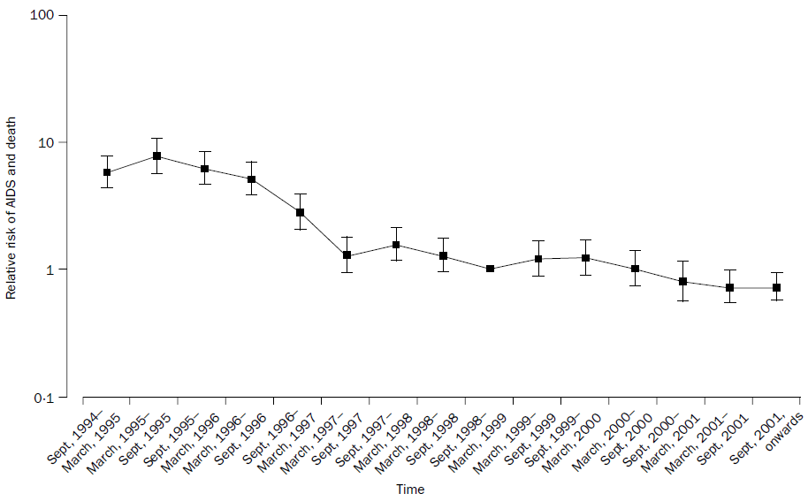
Adjusted relative risk of AIDS or death during the pre-HAART, early-HAART and late-HAART eras from the EuroSIDA Study
1996, HAART became available
Proportion of individuals with HIV infection dying in relation to introduction of HAART
Pre-HAART: 14.6%
Early-HAART: 7.4%
Late-HAART: 1.5%
Notes:
Narration
This slide shows the decline in the relative risk of developing AIDS-defining illnesses and death since the introduction of HAART (highly active antiretroviral therapy) in Europe. The death rate across Europe dropped rapidly and within 2 years of the widespread availability of HAART, the number of deaths were less than a fifth of that before HAART.
Source: Mocroft A. et al. Decline in the AIDS and death rates in the EuroSIDA study: an observational study (2003) ,The Lancet 362:22-29.

Slide 46
Improvements in mortality following the introduction
of effective therapy in UK
Notes:
Narration
This slide shows the positive impact the introduction of effective ARV therapy in 1996 had on both mortality (the grey line) and AIDS diagnoses (the yellow line).
Reference:
and need to acknowledge source on slide– PartnerRe.com, or source another slide (there are many)

Slide 47
Antiretroviral drug approval
NRTI, Nucleoside reverse transcriptase inhibitor PI, protease inhibitor
NNRTI, Non-nucleoside reverse transcriptase inhibitor
CCR5 antagonist / Entry inhibitor Integrase inhibitor
2008-2014
etravirine (2008)
rilpivirine (2011)
dolutegravir (2013)
elvitegravir (2014)
2001-2007
tenofovir (2001)
enfuvirtide (2003)
atazanavir (2003)
emtricitabine (2003)
fosamprenavir (2003)
tipranavir (2005)
darunavir (2006)
maraviroc (2007)
raltegravir (2007)
1994-2000
stavudine (1994)
lamivudine (1995)
saquinavir (1995)
ritonavir (1996)
indinavir (1996)
nevirapine (1996)
nelfinavir (1997)
delavirdine (1997)
efavirenz (1998)
abacavir (1998)
amprenavir (1999)
lopinavir/r (2000)
30
25
Total no.
of drugs
20
15
1987-1993
zidovudine (1987)
didanosine (1991)
zalcitabine (1992)
10
5
0
87
88
89
90
91
92
93
94
95
96
97
98
99
00
01
02
03
04
05
06
07
08
09
10
11
12
13
14
1
1
Year of FDA Approval
1
Notes:
Narration
There is an ever increasing number of ARV drugs available from 5 different classes. This provides patients and clinicians greater choice taking into account side effects, viral resistance and patient preference to maximize the chance of achieving the desired outcome of sustained viral suppression. Some of the older drugs are now rarely (if ever) used in clinical practice.
Source:

Slide 48
1. General profile of the HIV epidemic across Europe
2. Why Test for HIV?
3. Consequences of late diagnosis
4. Missed Opportunities
6. HIV testing strategies – including indicator condition guided HIV testing
5. Barriers to testing / Frequently raised concerns
Notes:
Narration
We know that for many individuals with undiagnosed HIV and for those who present late there have been many opportunities when they could have been diagnosed but were not offered an HIV test.

Slide 49
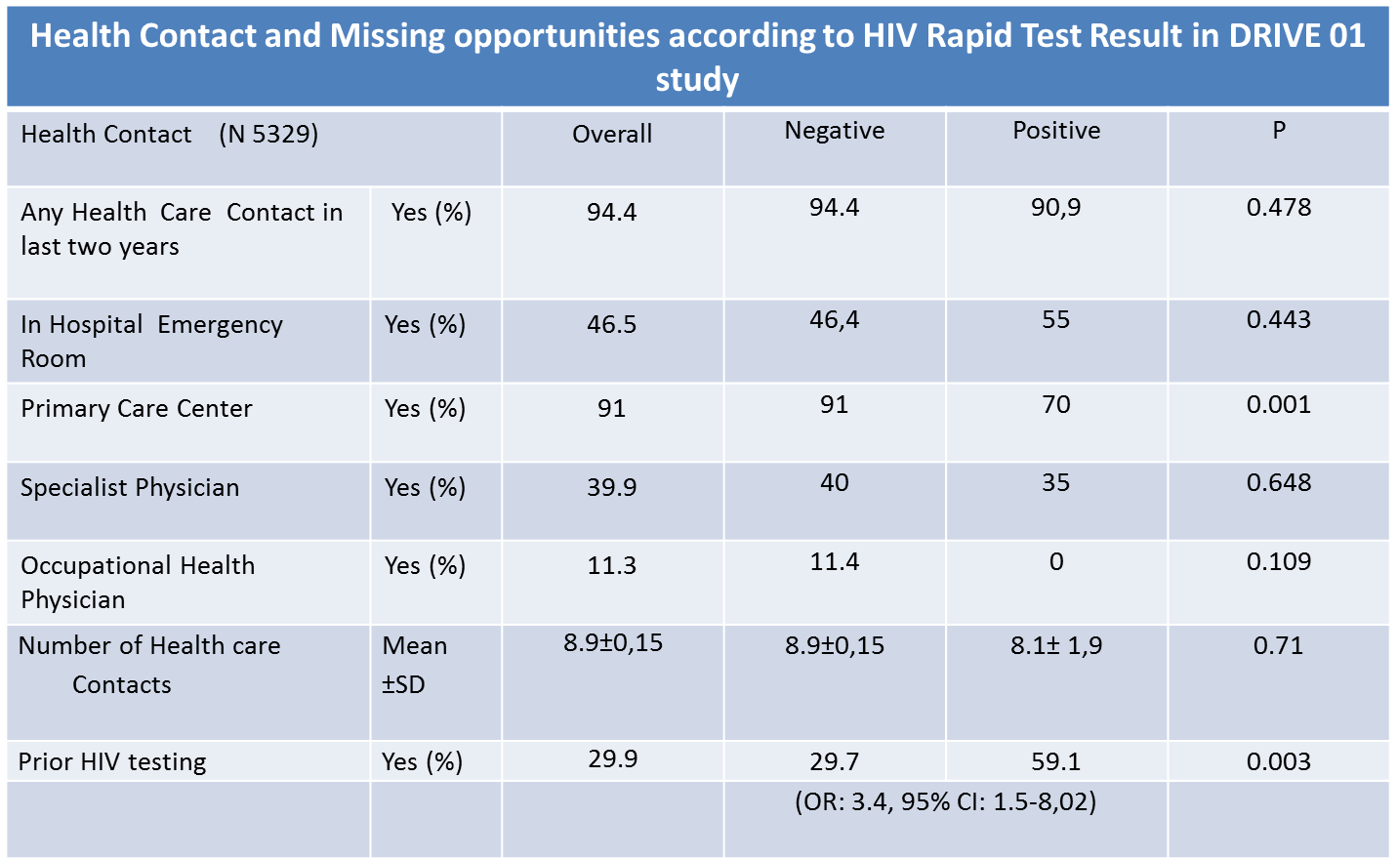
Missed opportunities for diagnosis
Missed Opportunities: 90.9%-59.1%=31.8%
Pérez Elías MJ, EACS 2013 PS8/3
Notes:
Narration: This study was performed among patients between 18 - 60 years old who recieved services at a Health Care Center or in a Hospital Emergency room in Madrid. Patient contact with health care providers was frequent in the last two years of the study, without differences between HIV-infected and non-infected patients.
When examining only newly confirmed HIV infections in the study, the study found that almost 91% of New HIV Diagnoses had had at least one Health care contact in the last two years before their HIV diagnosis. During this period, the same patients reported that 59% of them had been tested for HIV before. Therefore, the study was able to estimate that at least 32% of HIV infected patients had missed opportunities to be HIV diagnosed.
Further Information about the DRIVE study - Missed opportunities
The DRIVE study conducted 5329 questionnaires to examine HIV Risk Exposure and Clinical Conditions. Participants were asked if they had any contact with a health care professional and if a HIV test had been performed during the last two years.
Results from the study found that HIV infected patients had less frequent Primary Care Contact, but had more prior HIV testing (59.1% vs. 29.7%); (OR: 3.4, 95% CI: 1.5-8,02), p=0.003
Source: Pérez Elías MJ, Gómez Ayerbe C, Muriel A, Martínez M, Hernández B. Gutiérrez C, Pérez Elías P, Díaz A, Navas E Quereda C, Hermida JM, Moreno A, Dronda F, Casado JL, Moreno S. DRIVE Study Group. Prevalence of Hidden HIV Infection and Prior Sanitary Contact in DRIVE Study of Voluntary Routine HIV Diagnosis14th European AIDS Conference. Brussels 15-19 October. 2013. PS8/3
Oral communication

Slide 50
Missed opportunities for diagnosis - UK data
UK National audits (2005 and 2013)
17% accessed healthcare with symptoms in the year preceding HIV diagnosis
  37% reported a missed opportunity: commonly dermatology, haematology and gastroenterology
Brighton Study
62% accessed secondary care in the preceding year
  26% with an HIV-related problem
80% had been seen in primary care
  60% with an HIV-related problem
London Black African Cohort Study
76.4% had seen a GP in the year prior to diagnosis
Notes:
Narration
Sources:
BHIVA “New HIV Diagnoses Audit” 2005
Ottewill M et al, BHIVA 2006, Abstract P30
SONHIA 2008
Ellis, Clin Med 2013 –WHERE IS THIS DATA?

Slide 51
1. General profile of the HIV epidemic across Europe
2. Why test for HIV?
3. Consequences of late diagnosis
4. Missed opportunities
6. HIV testing strategies – including indicator condition guided HIV testing
5. Potential barriers to testing / frequently raised concerns
Notes:
Narration
Considering all the evidence we have seen so far, especially on the missed opportunities, it is difficult to explain why there continues to be such high levels of undiagnosed and late presentation; which can be simply addressed by increasing access to HIV testing. However, there are a number of potential barriers to expanding HIV testing which are frequently raised as concerns when discussing expanding HIV testing.

Slide 52
Frequently raised concerns about HIV testing
At patient level
At healthcare professional level
At institutional/policy level
Notes:
Narration
These concerns or potential barriers, can be divided into three broad categories, and occur at a patient level, at a service level, and at a higher institutional level or as the result of specific policies (either nationally or regionally).

Slide 53
Patient level: potential barriers
Patient level barriers vary from country to country
Cross-cultural barriers include:
  Low risk perception
  Fear of HIV infection and its health consequences
  Fear of disclosure
  Denial
  Difficulty accessing services
Notes:
Narration
Barriers and concerns experienced by an individual will vary to some extent form country to country, however there are some that are likely to be universal. These include factors relating to HIV stigma, perception of individual risk and access to welcoming services (particularly for migrant populations and other risk groups). Fear of disclosure can relate to the actual testing itself as well as for those who test positive. There is often a fear of anticipated rejection by significant others along with future employment concerns; even in the presence of protective legislation.
Source: Deblonde J et al. Barriers to HIV testing in Europe: a systematic review. European Journal of Public Health, 2010, Vol. 20, No. 4, 422–432.

Slide 54
Patient attitudes towards HIV testing (HINTS Study)
“It is acceptable to me to be offered an HIV test in this setting”
  Overall 92% of respondents agreed with this statement, n=1003
Test uptake |  | Proportion agreeing | p-value
 | Accepted test | 97% | <0.001
 | Declined test | 85%
Notes:
Narration
Prior to establishing HIV testing services in non traditional settings concerns have been raised that many patients would find it unacceptable to be offered an HIV test when accessing healthcare for a different problem, unrelated to HIV, as far as they are concerned.
The HINTS study examined this in more detail, asking patients who were offered an HIV test in a variety of settings (primary care, Hospital Emergency Department, Acute Admissions Unit and Dermatology Out-Patients) whether they thought it was acceptable to be offered a test. The vast majority agreed with this statement, and although there was a difference between those who accepted and those who declined, 85% of those who declined still felt it was OK
Source: Rayment M, Thornton A, Mandalia S, Elam G, Atkins M, Jone R, Nardone A, Roberts P, Tenant-Flowers M, Anderson J, Sullivan A. (2012) HIV Testing in Non-Traditional Settings - The HINTS Study: A Multi-Centre Observational Study of Feasibility and Acceptability. PLoS One 2012; 7(6):e39530. Epub 2012 Jun 22

Slide 55

Healthcare provider level: potential barriers and concerns
Insufficient staff time
Competing clinical priorities
Burdensome consent process
Perceived pre-test counselling requirements
Lack of staff knowledge and training
Perceived lack of competency
Patient not perceived to be at risk
Concerns patient may be upset/offended
Inadequate reimbursement
Notes:
Narration
Potential barriers also exist at the healthcare provider level. These fall into several categories; concerns about capacity and time perceived as required to deliver testing; staff concerns about their level of knowledge and competency; staff attitudes and possible misconceptions relating to patients in relation to risk and acceptability; and financial considerations.
Many of these can be addressed by simple training and education, however many are more systemic and harder to overcome; for example the cost of delivering an HIV testing programme may be borne by a different stakeholder than the one that sees the financial benefit from timely diagnosis.
Ref: Mounier-Jack Set al. HIV testing strategies across European countries. HIV Medicine (2008), 9 (Suppl. 2), 13–19. Sullivan AK, Raben D, Reekie J, Rayment M, Mocroft A, et al. (2013) Feasibility and effectiveness of indicator condition-guided testing for HIV: results from HIDES I (HIV Indicator Diseases across Europe Study). PLoS One 8: e52845. doi:10.1371/journal.pone.0052845.
Partridge DG et al. HIV testing: the boundaries. A survey of HIV testing practices and barriers to more widespread testing in a British teaching hospital International Journal of STD & AIDS 2009; 20: 427-428.
Can we improve animation so that the highlight box moves between themes

Slide 56
Staff attitudes towards HIV testing (HINTS Study, n=146)
Notes:
Narration
In the HINTS study, 146 staff in these four settings were asked to rate their agreement with the statements seen along the X axis:
96% staff were supportive of the need for increased HIV testing, and 84% thought it acceptable for HIV testing to be offered in their Department BUT only 54% staff agreed they would feel comfortable offering HIV tests themselves
Source: Thornton A, Rayment M, Mandalia S, Elam G, Atkins M, Jones R, Nardone A, Roberts P, Tenant-Flowers M, Anderson J, Sullivan A. Exploring staff attitudes to routine HIV testing in non-traditional settings: a qualitative study in four healthcare facilities. Sex Transm Infect 2012 ;88:601-6

Slide 57
Institutional level: potential barriers and ways to address concerns
Increased costs
It is cost effective if diagnose at least 1 person for every 1000 tested
Consider the cost to the Institution of missed HIV diagnosis due to future higher costs
Perceived low probability of finding new diagnoses
Present the HIDES results
Impact on existing services
Simplify consent procedures, opportunistic testing
Simplify consent procedures, opportunistic testing
Notes:
Narration
The increased costs are often cited as a major barrier to the expansion of HIV testing, especially as in many instances the cost of delivering the testing is in a different service or institution to the one receiving the benefit of earlier and increased diagnoses.
Cost effective data, mainly from the US and France, suggests that it if an HIV testing programme delivers a test positivity of 1 per 1000, that is 0.1% HIV prevalence it will be cost effective. It can be informative for a service which delivers both testing and care to review the costs borne by the Institution due to opportunities they (or others) have missed within their current HIV cohort.
As HIV cohorts in single institutions tend to be relatively small compared to other specialties, there is often a low expectation of expected new diagnoses. Data from the HIDES study, audits and reviews of past medical histories of current HIV patients can inform these concerns.
Potential opportunity costs can largely be mitigated by integration into the routine care pathway, simplifying the consent procedure, reviewing the ways patients are provided with information.

Slide 58
Policy and regulatory barriers
This slide to be locally adapted if there are potential policy and/or regulatory related barriers, for e.g. who can perform a test. Consider including information here about issues pertaining specifically to MSM, undocumented migrants’ access to healthcare and PWID in those countries this is a particular issue

Slide 59
1. General profile of the HIV epidemic across Europe
2. Why Test for HIV?
3. Consequences of late diagnosis
4. Missed Opportunities
6. HIV testing strategies – including indicator condition guided HIV testing
5. Barriers to testing / Frequently raised concerns
Notes:
Narration
There are a number of different strategies that can be employed to increase HIV testing. It is important to be aware of the characteristics of your local epidemic so as to inform the best fit, or a combination of a number of different approaches.

Slide 60
1. General profile of the HIV epidemic across Europe
2. Why Test for HIV?
3. Consequences of late diagnosis
6. HIV testing strategies – including indicator condition guided HIV testing
Notes:
Narration
There are a number of different strategies that can be employed to increase HIV testing. It is important to be aware of the characteristics of the local epidemic so as to inform the best fit, or a combination of a number of different approaches.

Slide 61
HIV Testing Strategies
Focus on the person
Individuals in high risk groups
MSM, PWID, BME
Termination of pregnancy services
Substance misuse services
Sexual health clinics
Antenatal clinics
Clinical
Focus on the setting
Community
Focus on the location
Areas with high diagnosed sero-prevalence
Focus on the condition
HIV indicator conditions
Notes:
Narration
These strategies can be divided into 4 main categories
Programmes can advocate targeting testing at individuals belonging to high risk group MSM, BME, PWID, migrants.
They can focus on offering testing in locations where individuals at higher risk may attend; such as sexual health clinics, TOP services, antenatal clinics, substance misuse services. Non-medical settings in the community, which deliver services for those at most risk groups, often by peers or community workers, has recently been endorsed and supported by the WHO and there are a number of very successful examples such as checkpoint in Barcelona.
We can also focus on the location by offering universal testing in healthcare services in regions with high levels of undiagnosed HIV. Using the local diagnosed prevalence and the estimated undiagnosed proportion the expected test positivity rate can be estimated; this strategy is recommended if this exceeds 1/1000 (which equates to a prevalence of 0.1%, the cost effective threshold.
Finally we can promote indicator condition led testing, whereby patients presenting for management of certain conditions should be offered an HIV test as the sero-prevalence exceeds 0.1%

Slide 62
HIV Testing Strategies
PERSON
Individuals in high risk groups
MSM, PWID, BME
Termination of pregnancy services
Substance misuse services
Sexual health clinics
Antenatal clinics
Clinical
PLACE
Community
POPULATION
Areas with high diagnosed sero-prevalence
PROBLEM
HIV indicator conditions
Notes:
The strategies can be divided into 4 main categories, and we can target our testing efforts based on the person, the place, the population or the problem
Programmes can advocate targeting testing at the person: those individuals belonging to high risk group MSM, BME, PWID, migrants.
They can focus on offering testing in certain places where individuals who are at higher risk may attend; such as sexual health clinics, TOP services, antenatal clinics, substance misuse services. Non-medical settings in the community, which deliver services for those at most risk groups, often by peers or community workers, has recently been endorsed and supported by the WHO and there are a number of very successful examples such as checkpoint in Barcelona.
We can focus on the population by offering universal testing in healthcare services in regions with populations with high levels of undiagnosed HIV. Using the local diagnosed prevalence and the estimated undiagnosed proportion the expected test positivity rate can be estimated; this strategy is recommended if this exceeds 1/1000 (which equates to a prevalence of 0.1%, the cost effective threshold).
Finally we can target individuals with indicator conditions (being the ‘problem’), whereby patients presenting for management of certain conditions should be offered an HIV test as the sero-prevalence exceeds 0.1%

Slide 63
Notes:
Narration
Several organisations at International, regional, national and specialty levels, produce HIV testing guidelines.
WHO have now published consolidated guidelines for HIV testing services, which cover all facets of delivering an HIV testing programme

Slide 64
Notes:
Narration
The ECDC guidance on how to increase HIV testing uptake were published in 2010 and are currently being evaluated and updated

Slide 65

BHIVA/BASHH/BIS UK National Guidelines for HIV Testing, September 2008
Recommendations:
Targeted screening: risk groups
Targeted screening: indicator diseases
Routine screening: specific settings
Routine screening: in general medical settings when local diagnosed HIV prevalence > 0.2%
NICE Public Health Guidelines – March 2011
Increasing the uptake of HIV testing among black Africans in England
NICE public health guidance PH 33 and men who have sex with men PH 34
Notes:
Narration

Slide 66
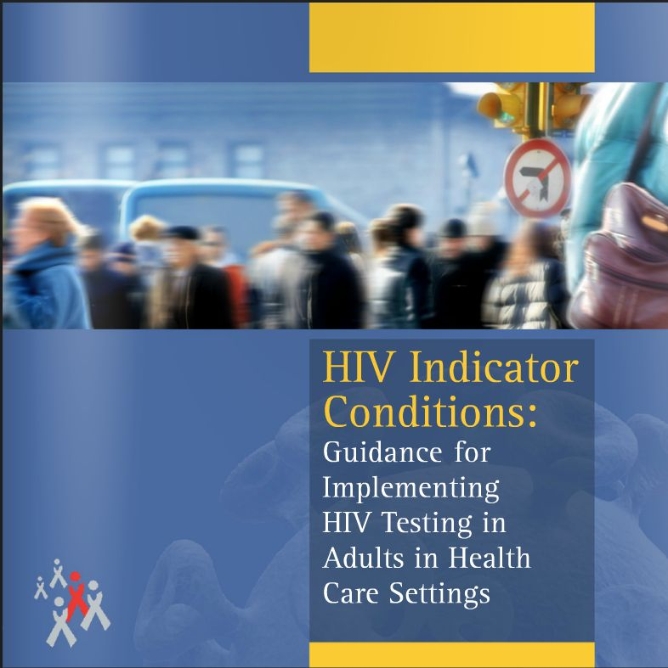
Notes:
Narration
HIV in Europe have worked with a wide range of stakeholders to produce European guidelines for HIV testing in Indicator Conditions. This also provides a number of useful implementation and evaluation tools.

Slide 67
HIV Indicator Condition Guided Testing
Indicator conditions are conditions associated with an excess risk of being HIV-positive
There is a growing evidence base for HIV prevalence in different indicator conditions
Routine HIV testing is cost effective when the undiagnosed HIV prevalence in the target group >0.1%
Indicator condition guided HIV testing is included in many HIV testing guidelines but there is very variable implementation
This was the driver for the HIV Indicator Diseases Across Europe Study (HIDES)
Notes:
Narration
So what exactly is Indicator Condition targeted HIV testing?
Indicator conditions are associated with an increased risk of HIV infection; many of these condition also occur at higher rates in HIV infected individuals either because they share a route of transmission (e.g. hepatitis) or due to the nature of the underlying immune deficiency.
Until fairly recently there was little evidence for the undiagnosed HIV prevalence in individuals presenting with specific indicator conditions; however there is now a growing evidence base for this strategy.
As mentioned previously HIV testing is deemed to be cost effective at an undiagnosed HIV prevalence of 0.1%, and indicator condition testing is increasingly being incorporated into a number of guidelines, however implementation is variable.
To expand the evidence underpinning this strategy the HIDES study was carried out.

Slide 68
What is indicator condition guided HIV testing?
This is an approach where healthcare professionals routinely offer an HIV test to all individuals presenting with an indicator condition because the condition is associated with undiagnosed HIV infection.
Studies indicate that routine HIV testing is cost-effective when the undiagnosed HIV prevalence in individuals with a specific indicator condition is > 0.1%.
The concept of indicator condition guided HIV testing is an approach whereby health care professionals can be encouraged to offer tests to patients based on the presence of an indicator condition rather than risk behaviour or group. This potentially addresses many of the barriers felt by patient and health care providers to HIV testing.
Notes:
Narration
Indicator Condition testing is when all patients presenting for care of a specific condition are routinely offered an HIV test.
We define an Indicator Condition as one having an undiagnosed HIV sero-prevalence of 0.1%; which is the cost effective threshold
By testing the condition or the presenting problem no risk assessment is required to initiate the test offer; potentially addressing many of the barriers to testing.

Slide 69
Indicator Conditions
Categories
Conditions which are AIDS defining
2.a Conditions associated with an undiagnosed HIV prevalence > 0.1%
2.b Other conditions which by expert opinion are considered
likely to have an undiagnosed HIV prevalence of > 0.1%.
Conditions where not identifying the presence of HIV infection may have significant adverse implications for the individual’s clinical management.
The HIDES Study (HIV Indicator Diseases Across Europe Study) investigated the HIV prevalence within potential indicator conditions across Europe.
Notes:
Narration
There are three broad categories of Indicator Conditions. The first are those that are AIDS defining for example PCP, NHL, cerebral toxoplasmosis; there are X conditions in total. The second category are those that have demonstrated or presumed undiagnosed HIV prevalence of 0.1%; it is largely the case for condition sin the second subcategory of 2b that data on is not yet available. The final category includes those conditions where undiagnosed infection poses a significant risk to successful management of the indicator condition; for example immunosuppressive therapies.
To further define which conditions meet the status of indicator condition a three phase, pan-European study was conducted – the HIDES study.

Slide 70

HIDES – Phase 2, 2012-2014
Routine offer of HIV test to patients (18-65 yrs) presenting with indicator condition
Primary endpoint: demonstration of previously undiagnosed HIV infection >0.1% in each indicator condition (IC)
Disease Area | Indicator Conditions
Malignancies | Lymphoma Cervical dysplasia or cancer (CIN II and above) Anal dysplasia or cancer (AIN II and above) Primary lung cancer
Viral infections | Hepatitis B infection Hepatitis C infection Hepatitis B & C co-infection Ongoing mononucleosis-like illness
Haematological disorders | Leucocytopaenia and / or thrombocytopaenia Lymphadenopathy
Dermatological | Severe psoriasis Seborrhoeic dermatitis
Other | Pneumonia (hospitalised) Peripheral neuropathy
Notes:
Narration
In all three phases of the HIDES study an HIV test was offered to all patients presenting for care of specific conditions.
HIDES phase 1 was a feasibility study which confirmed the IC status of a number of key IC, two of the initial 8 ICs were not continued into phase 2 due to data obtained in HIDES 1. These were STI and Herpes Zoster in patients younger than 65
Phase 2 conditions are shown on this slide
The primary end point was HIV prevalence
Additional information
STI 4.06 (2.78-5.71)
Herpes Zoster <65yo 2.89 (1.07-6.21) [prevalence(95%CI)]
Source: Sullivan AK, Raben D, Reekie J, Rayment M, et al., Feasibility and effectiveness of indicator condition-guided testing for HIV: results from HIDES I (HIV indicator diseases across Europe study). PLoS One 2013;8(1):e52845. doi: 10.1371/journal.pone.0052845. Epub 2013 Jan 15.

Slide 71
Enrolment
150 surveys were performed, across 42 clinical centres in 20 countries across four regions of Europe
10,139 patients were enrolled
668 participants were excluded
Total of 9471 participants
Recruitment by region | Number enrolled | %
Total | 9471 | 100
South | 500 | 5.3
Central | 942 | 10.0
North | 2297 | 24.3
East | 5732 | 60.5
Notes:
Narration
150 surveys were performed, across 42 clinical centres in 20 countries across four regions of Europe. A total of 9,471 patients were included, the majority from Eastern Europe, followed by Northern Europe.
Additional information – the European regions correspond to those used in EUROSIDA –a large European HIV cohort study
NEED TO LIST COUNTRIES BY EUROSIDA REGION here

Slide 72
Characteristics of participants
Participants 9471
Male 54%
Median age 37 years (IQR 29-49 years)
White 87%
Previous HIV test 14%
- median time since last test: 1.3 years [IQR 0.4 – 3.2 years])
Setting:
 | Number enrolled | %
Total | 9471 | 100
Outpatient | 4500 | 47.5
Inpatient | 3564 | 37.6
Primary Care | 270 | 2.9
Unknown | 1137 | 12.0
Notes:
Narration
There were almost nine and a half thousand participants, the majority were male, white and the median age was 37.
Very few had previously tested for HIV
Almost half were recruited form Hospital outpatient departments
Only a small percentage were form Primary Care as there was only a small number of Primary Care sites. HIDES Phase 3 is an extension of the Infectious mononucleosis like illness arm; with an increased number of primary care sites involved in recruitment.

Slide 73
HIV test positivity (overall)
235/9471 individuals tested HIV positive
HIV prevalence: 2.5% [95%CI 2.2 – 2.8]
Marked variation by region:
Region | Number enrolled | Number HIV+ | % | 95%CI
All | 9471 | 235 | 2.5 | 2.2 – 2.8
South | 500 | 25 | 5.0 | 3.1 – 6.9
Central | 942 | 10 | 1.1 | 0.4 – 1.7
North | 2297 | 31 | 1.4 | 0.9 – 1.8
East | 5732 | 169 | 3.0 | 2.5 – 3.4
Notes:
Narration
235 individuals tested positive for HIV giving a prevalence of 2.5%. This is 25 times higher than the level required to meet the IC definition.

Slide 74
HIDES Phase 2 - HIV prevalence by indicator condition
0.1% and LL 95%CI>0.1%
95% CI > 0.1
95% CI < 0.1
Tested | 73 | 734 | 401 | 722 | 1881 | 84 | 1751 | 299 | 1126 | 1339 | 588 | 276 | 53 | 144
HIV+ | 7 | 39 | 16 | 32 | 61 | 2 | 41 | 6 | 13 | 13 | 4 | 1 | 0 | 0
Notes:
Narration
Breaking this down into the separate indicator condition you can see those conditions to the left of the line meet the IC definition. There were a small number of both patients and events in the three conditions to the right, and more data is required for them

Slide 75
HIDES Phase 2 - Odds of testing HIV+ by indicator condition (adjusted)
Indicator Condition:
Pneumonia
Cervical dysplasia
Hepatitis B
Hepatitis C
Mononucleosis-like illness
Leuco / thrombocytopaenia
Lymphadenopathy
All others
Model adjusted for gender, ethnicity, previous HIV testing history, European region, setting, age, date, and number from centre
Adjusted odds of testing HIV+ (95% CI)
Notes:
Narration
Factors making it more likely to test positive included being male, non-white and from Eastern compared to Central Europe. Indicator Condition was also an independent predictor with infectious mononucleosis like syndrome and blood dyscrasias associated with increased odds of an HIV positive test. This may prove practically useful data where programmes are planned in a roll out fashion, or where limited resources may need to be focussed on areas of highest need.

Slide 76
HIDES Phase 2 - Characteristics of newly diagnosed participants
Median CD4 count 200 cells/μl (IQR 65 – 390)
Late presenters 143 71.9%
History of HIV-associated 61 28.2%
symptoms
Notes:
Narration
For those newly diagnosed in HIDES Phase 2 the majority were diagnosed late with a median CD4 count of only 200. Nearly 30% reported experiencing HIV related symptoms prior to their diagnosis; representing missed opportunities for earlier diagnosis

Slide 77
Conclusion
There is an urgent need to increase HIV testing and diagnosis, so as to decrease both late presentation and the number of individuals with HIV infection who remain unaware of their status.
This will decrease morbidity, mortality, transmissions and healthcare costs.
Indicator condition based testing is an effective and efficient strategy within healthcare settings to expand HIV testing and more timely diagnosis

